Slide 1
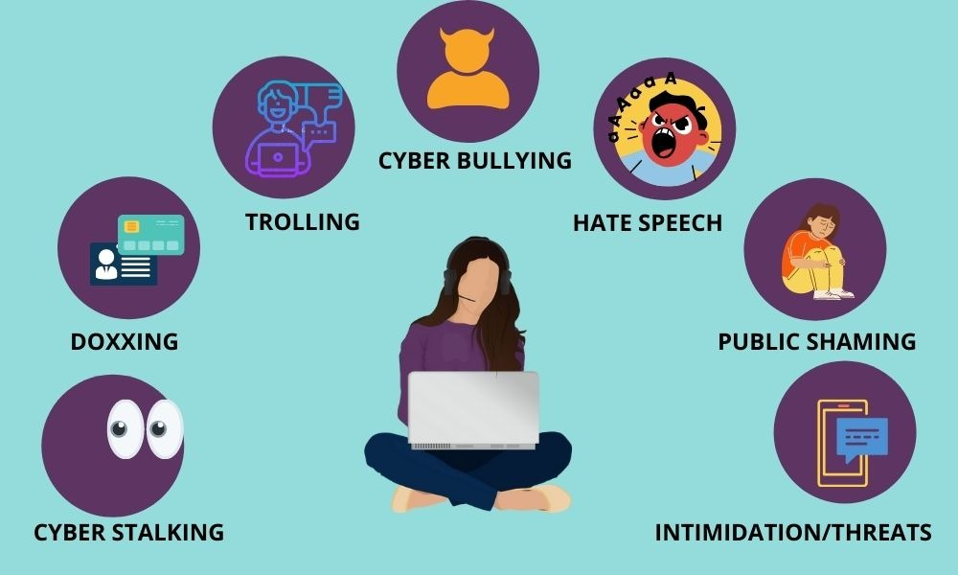
SafeNet AI: Protecting Women Online
Privacy
Safety
Empowerment

Slide 2

The Unseen Threat
The Reality of Online Harassment
Women disproportionately face online harassment, stalking, and privacy violations. This isn't just an inconvenience; it impacts mental health, career prospects, and personal safety.
Cyberstalking: 1 in 4 women experience severe online stalking.
Privacy Leaks: Non-consensual sharing of private information is rampant.
Harassing Messages: A constant barrage of offensive or threatening communication.

Slide 3
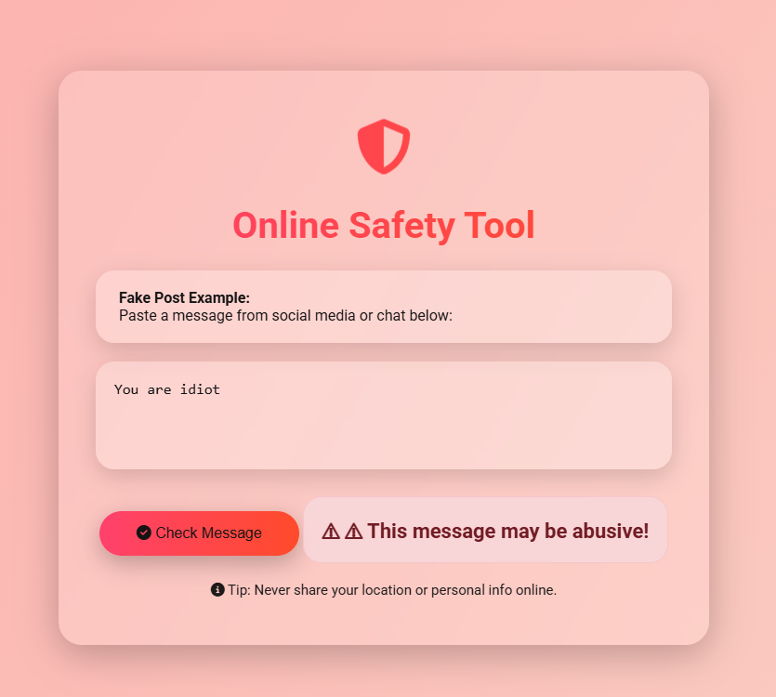
Our Solution
SafeNet AI: Message Checker in Action
Our core demo, the Message Checker, is a real-time tool to detect harassment keywords in any text conversation. It provides immediate, actionable feedback, allowing users to identify and address threatening or offensive content before it escalates.
Live Demo Ready: See SafeNet AI prevent harm in real-time.

Slide 4


Expanding Protection
Media Analysis & Stalker Alerts
Screenshot/Media Analyzer
Stalker Alert
Upload images or screenshots, and our AI highlights harassing or offensive content, even in visual form.
Detects repeated or fake accounts targeting users across platforms, identifying persistent threats.

Slide 5

Proactive Defense
Privacy Checker & Emergency SOS
Privacy Checker
Scans for sensitive personal information (phone numbers, addresses) being shared online without consent, alerting users to potential leaks.
Emergency SOS Button
A one-click solution to instantly alert trusted contacts or report severe harassment directly to authorities.

Slide 6
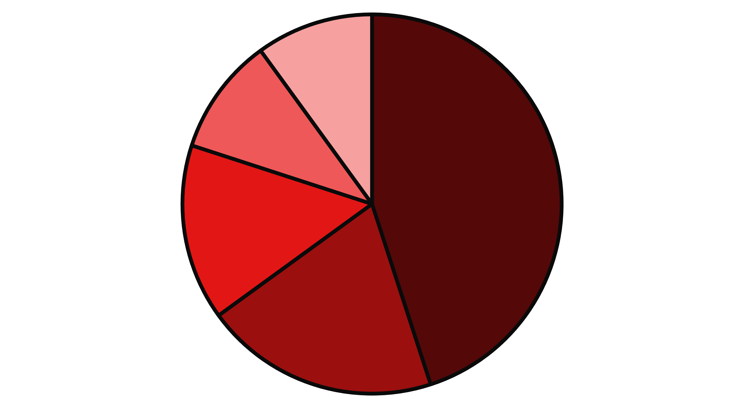
Understanding the Landscape
Dashboard & Analytics
SafeNet AI provides a comprehensive dashboard, visualizing harassment trends. Users can understand the categories, frequency, and severity of incidents, empowering them with data to identify patterns and seek support.
Verbal Abuse
Cyberstalking
Privacy Violation
Threats
Impersonation
This data helps users understand their exposure and provides valuable evidence for reporting.

Slide 7






The Future
The SafeNet AI Toolkit
All these features seamlessly integrate into one powerful platform: the SafeNet AI Toolkit. From real-time monitoring to proactive alerts, we're building a comprehensive digital safety net for women online.
AI Toolkit
Dashboard
Central processing and orchestration
Real-time monitoring and alerts
User
Safety Tools
Output
Interacts with SafeNet AI Toolkit
Message, Screenshot, Stalker, Privacy, SOS
Enhanced safety and empowerment
A unified approach to Privacy, Safety, and Empowerment.

Slide 8
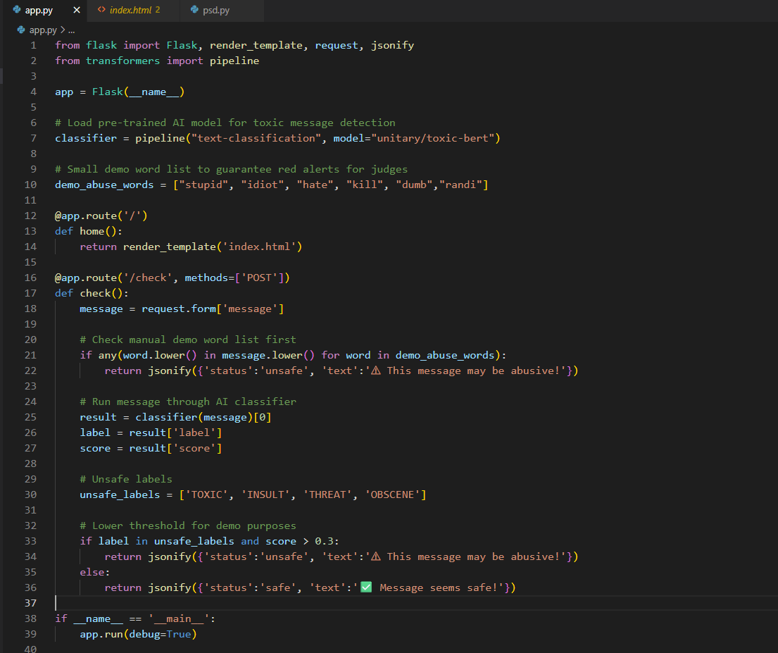
Under the Hood
Technical Implementation
Tech Stack
Privacy-First Approach
Backend: Flask, Python
NLP: Hugging Face models for robust text analysis
Local execution is paramount. SafeNet AI is designed to run locally on the user's device, ensuring no sensitive data leaves their environment. We eliminate server-side storage of personal content, guaranteeing user privacy and security.
UI: HTML/CSS for a clean, intuitive interface
Image Processing: Python libraries for media analysis

Slide 9




Path Forward
Impact & Scalability
Browser Extension
Target Users
Easily integrate with web browsers for seamless real-time protection.
Students, corporate professionals, NGOs – anyone vulnerable to online harassment.
Multilingual Support
Mobile App
Break language barriers to offer global protection against online threats.
Expand to iOS and Android for on-the-go protection and alerts.
A scalable solution to create a safer digital world for everyone.

Slide 10

Thank You
Team TechWasps
MANAV BATRA 24BCE10235
ASHWIN SHARMA 24BCE10351
PRAKASH ROY 24BAI10318
Together, we can build a safer, more empathetic internet.

